Slide 1
C3 - Cardiac Care Skills
In conjunction with the remote simulation program simulation session
Module C3

Slide 2
Sponsor
This project was possible due to funding made available by
Projects within NSW are overseen by the NSW Ministry of Health on behalf of HWA

Slide 3
Introductions
Notes:
Very quick round the room to assess stage of professional development for each participant.

Slide 4
General Aims
Learn in a team setting
Blend clinical skills with team skills
Reflect critically on practice
Notes:
This session, and package as a whole, involves learning together. Learning with the teams that you work with helps that team to function more efficiently and effectively. It allows you to learn from each other, explore different perspectives and to understand the importance of all members of the team.
We are targeting higher level learning – applied skills and performance in contextualised events. This is through team discussion and also through working through simulated scenarios as a team. It also allows you to put into practice knowledge attained from the eLearning and other solo learning environments.
To review and reflect upon our own practice and current best practice standards. During our feedback sessions we will facilitate this but we would also encourage you to reflect on your practice and experience after these sessions.

Slide 5
Session Objectives
Commence observations and monitoring for people with chest pain
Perform a 12 lead ECG
Discuss basic cardiac investigations
Demonstrate management of symptoms - O2 therapy; fluids, pain
Discuss basic interpretation of an ECG
Escalate care when appropriate
Notes:
This session aims to begin with the reception of people with chest pain into the emergency room and to consider what are the appropriate observations, investigations and the symptomatic management. We will also review important time frames and when to escalate care.

Slide 6
Ground Rules
Participation
Privacy
Confidentiality
Disclaimer
Debriefing
Mobile phones
Notes:
Challenge of video conferencing tips: don’t change your seat, speak up nice & clearly
Details collected and de-identified for reporting purposes
Signed form, don't speak outside about how people performed as not necessarily indicative of real life, chance to try new things, don’t tell anyone about the scenarios as used again.
Training based on evidence based practice but refer to local policies and protocols
Debriefing chance to reflect upon what we did and how that translates to the workplace. Explore the complexities of performance and decision making.
Mobile phones on vibrate please

Slide 7
Pause and Discuss
Commence scenario
Pause to discuss what has happened so far
Practise new skills
Restart scenario and continue patient care
Notes:
Its important at the start of this workshop to outline what a pause and discuss scenario entails.
This is a style of learning which is suited to practising skills within a scenario.
It begins with the participants commencing the scenario and undergoing usual patient care practises. At a point during the scenario the facilitator will pause the scenario to discuss the learning objectives, the events so far or to help the participants prepare for where the scenario will be heading. It may also pause to emphasise things done well, to highlight these behaviours for those observing or others within the scenario.
After a pause, then scenario will restart, most commonly where it was left off, but on occasion the scenario may be “reversed” or “sped up” in the interests of learning.
This may occur several times in a scenario, depending on the learning needs of the group.
(for facilitators only – the advantage of this style of learning is it will allow the scenarios to be tailored to the learning needs of each particular group)

Slide 8
Scenario
Clark Kent
45 year old man, presents with 5 minutes of chest pain.
He has been triaged category 2 to an acute bed. His pain has now resolved.
Notes:
Presentation of simple chest pain patient – pain resolved
Start with 2 nursing volunteers (preferably junior or student nurses).
Ask the nurses to assess the patient and implement any actions they feel are appropriate. Pause after they appear to have finished the initial assessment and taken vitals +/- ECG.
Discussion points: sizing of BP cuff, what other observations, how to decide to monitor or not, proper lead placement and mnemonics in common use (white to right, smoke over fire etc), application of O2 – how much and what type mask.
Recommence with 12 lead ECG if not already done. Ask them to indicate chest and limb cable placement.
Discussion points: Timeframe to ECG and reasons for benchmark. Review of ECG for quality.
Finish scenario with medical officer arriving to see patient and nurses giving handover.
Discussion point: Handover style & content ? Use of ISBAR

Slide 9
Skill Revision
Appropriate cuff sizing
Accurate lead placement for 12 Lead ECG
Apply continuous ECG monitoring
Notes:
Following the scenario it is important to re-cap on the skills which were demonstrated by the team and/or the facilitators in the room.
Briefly ensure that the participants are comfortable with these skills.
Points for clarification or trouble shooting these procedures in the emergency department are important to review.

Slide 10
ECG Monitoring
Notes:
Each dept will have different protocols. The minimum requirement is for 3 leads RA (white), LA (black) and LL (red). Additional leads are RL (green) and V (brown). Many monitors require a V lead to count respirations.

Slide 11
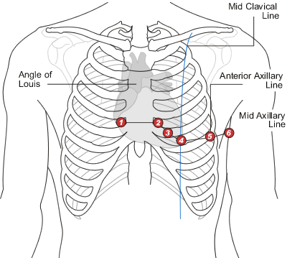
ECG lead Placement

Slide 12
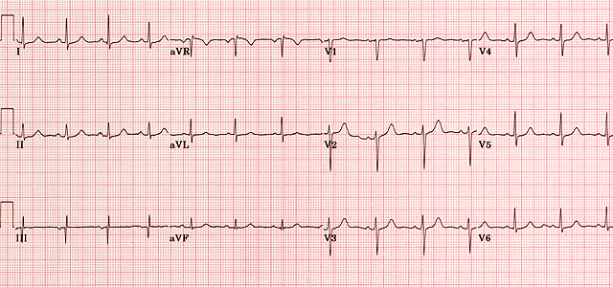
12 Lead ECG
Notes:
This is an image of a normal 12 lead ECG, there are no worrying features on this ECG.

Slide 13
Scenario
Susan Sarandon
65 year old woman, presents with 3/10 chest pain for the past hour. She has a history of high cholesterol, hypertension, diabetes and left sided mastectomy for breast cancer. She has had aspirin and GTN with the ambulance
She has been triaged category 2.
Notes:
Presentation of Chest pain, pain ongoing – NSTEMI
Patient arrives, onto monitor, BP, 12 lead ECG, Insertion of IVC/blood tests, Analgesia to request from medical staff
Pause and Discuss points – Above, plus for more senior group - Early investigations in chest pain – ECG and investigations to send

Slide 14
Skill Revision
Blood pressure measurement considerations
Perform a 12 Lead ECG
Discuss basic interpretation of an ECG
Discuss basic cardiac investigations
Notes:
Following the scenario it is important to re-cap on the skills which were demonstrated by the team and/or the facilitators in the room.
Briefly ensure that the participants are comfortable with these skills.
Points for clarification or trouble shooting these procedures in the emergency department are important to review.
Recall that the patient had a left sided mastectomy with lymph node removal, blood pressure measurement and phlebotomy should be avoided on this arm, other contraindications for using a particular side for BP measurement include fistula in situ for dialysis (or if planned this is also preferred), pain, fractures or other pathology which is localised to a particular limb.
Worrying features on ECGs will be discussed on the next slide.
Basic Cardiac investigations include chest xray to exclude other causes, blood results of CK and troponin for cardiac risk stratification and other tests to either rule in or rule out of the pathology should be considered. The indications for each of these tests is beyond the scope of this talk, senior advice should be taken before ordering these tests, as there is often significant impact on ongoing management.

Slide 15
Worrying ECG Features
ESSENTIALLY THINK DOES THIS LOOK NORMAL??
Tachycardia or Bradycardia
ST elevation
ST depression
Wide QRS complexes
T wave inversion
Q waves
Heart Blocks/Arrhythmias
Notes:
There are many worry features on the ECG, it can take years to even begin to understand these changes.
ALL ECG must be performed in all chest pain patients within 10 minutes of their arrival in the emergency department and must reviewed urgently by a senior doctor, with experience interpreting ECGs.
Essentially the first question to ask is does this look normal?
Worrying features on the initial ECG include -
Tachycardia, bradycardia,
ST segment changes - elevation or depression
Widening of the QRS complexes
T wave inversion
Q waves
Heart blocks
Arrhythmias

Slide 16
Scenario
Boy George
57 year old man presents with chest pain on a background of previous AMI and obesity. Aspirin and GTN have been given.
He has been triaged category 2.
Notes:
Presentation of chest pain – Inferior infarction
Patient arrives onto monitor, BP, 12 lead ECG, insertion of IVC,Bloods, Early management of chest pain – analgesia, aspirin, Recognition of abnormal ECG, Handover to medical staff, When do to bilateral BPs, For more senior group Right sided/Posterior ECGs
Pause and Discuss – Bilateral BPs (consider aortic dissection in the differential), Recognition of abnormal ECGs, Other ECGs

Slide 17
Skill Revision
Early monitoring of cardiac chest pain
Discuss basic interpretation of worrying ECGs
Discuss ordering basic investigations
Demonstrate management of symptoms - O2 therapy; fluids, pain
Escalate care when appropriate
Notes:
Following the scenario it is important to re-cap on the skills which were demonstrated by the team and/or the facilitators in the room.
Briefly ensure that the participants are comfortable with these skills.
Points for clarification or trouble shooting these procedures in the emergency department are important to review.
The scenario presented is one of a time critical emergency. This patient has significant pathology.
Early handover using ISBAR and a coordinated team approach are the appropriate way to access rapid senior input.
The 12 lead ECG demonstrates worrying features, urgent revascularisation is required.
Consideration of bilateral blood pressures for possible dissection is appropriate in patients with inferior changes, and should be performed in all patients with chest pain who are hypotensive.

Slide 18
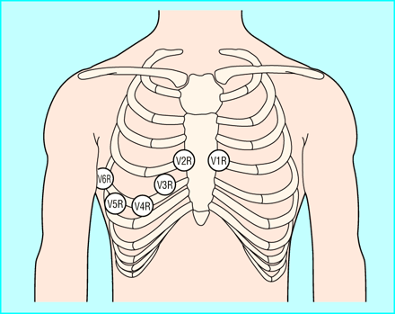
Right-Sided ECG Lead Placement
Reproduced from Morris and Brady, 2002.
Notes:
Seeks a right ventricular infarction
When to perform a right sided ECG
If inferior ST elevation changes are present
If the patient is hypotensive
Known or suspected dextrocardia
If requested for other reason

Slide 19
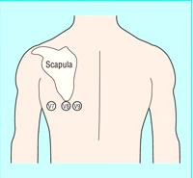
Posterior ECG Lead Placement
Notes:
Seeks a posterior infarction
When to perform a posterior ECG
- ST depression in V1-V3
Inferior or lateral STEMI
-Hypotension
Remember that ST depression of subendocardial ischaemia doesn’t localise, seek the STEMI.

Slide 20
Summary
Basic skills in Cardiac Care including blood pressure, ECG and monitoring are required urgently in chest pain patients.
Recognition of abnormalities requires escalation and further investigations
Clear communication and handovers are important steps in Cardiac Care
Notes:
This is a summary of the basic points of this work shop – the skills revised have been mentioned throughout the module. It should be pointed out the the participants that these skills are basic emergency department skills and should be rehearsed until they are familiar with them.
Following this workshop if these skills need to be clarified the participants should be advised to seek a local mentor to further demonstrate these skills.

Slide 21
Acknowledgments
C3 Topic expert author: Clare Richmond
C3 Simulation session author: Clare Richmond
Cardiac Module Expert Working Party and Peer Review Team Michael Bastick FACEM Gosford Hospital Sandra Cheng Simulation Fellow SCSSC John Kennedy FACEM Royal North Shore Hospital Marian Lee FACEM Prince of Wales Hospital John McKenzie FACEM Australian Institute for Clinical Education (AICE) Clare Richmond FACEM Royal Prince Alfred Hospital Morgan Sherwood Simulation Fellow SCSSC Timothy Tan Simulation Fellow SCSSC John Vassiliadis FACEM Royal North Shore Hospital
Educational consultants:
Stephanie O’Regan Nurse Educator SCSSC Leonie Watterson Director Simulation Division SCSSC John Vassiliadis Deputy Director SCSSC
Clare Richmond FACEM Royal Prince Alfred Hospital Morgan Sherwood Simulation Fellow SCSSC

Slide 22
Disclaimer Care has been taken to confirm the accuracy of the information presented and to describe generally accepted practices. However the authors, editor and publisher are not responsible for errors or omissions or for any consequences from the application of the information in this presentation and make no warranty, express or implied, with respect to the contents of the presentation.
Copyright and Permission to Reproduce
This work is copyright. It may be reproduced for study or training purposes subject to the inclusion of an acknowledgement of the source: Health Workforce Australia EdWISE program. It may not be reproduced for commercial usage or sale.

