Slide 1
Basic Life Support Advanced Life Support
In conjunction with the remote simulation program simulation session
Cardiac Module C4

Slide 2
Sponsor
This project was possible due to funding made available by
Projects within NSW are overseen by the NSW Ministry of Health on behalf of HWA

Slide 3
Introductions
Notes:
Very quick round the room to assess stage of professional development for each participant.

Slide 4
General Aims
Learn in a team setting
Blend clinical skills with team skills
Reflect critically on practice
Notes:
This session, and package as a whole, involves learning together. Learning with the teams that you work with helps that team to function more efficiently and effectively. It allows you to learn from each other, explore different perspectives and to understand the importance of all members of the team.
We are targeting higher level learning – applied skills and performance in contextualised events. This is through team discussion and also through working through simulated scenarios as a team. It also allows you to put into practice knowledge attained from the eLearning and other solo learning environments.
To review and reflect upon our own practice and current best practice standards. During our feedback sessions we will facilitate this but we would also encourage you to reflect on your practice and experience after these sessions.

Slide 5
Session Objectives
Recognition of cardiac arrest
Apply the ARC BLS algorithm early in cardiac arrest
Progress to the ARC ALS algorithm
Use a Defibrillator in ALS
Be familiar with drugs used in ALS
Notes:
These need to reflect the objectives of your session in both the skills and human performance aspects.

Slide 6
Ground Rules
Participation
Privacy
Confidentiality
Disclaimer
Debriefing
Mobile phones
Notes:
Challenge of video conferencing tips: don’t change your seat, speak up nice & clearly
Details collected and de-identified for reporting purposes
Signed form, don't speak outside about how people performed as not necessarily indicative of real life, chance to try new things, don’t tell anyone about the scenarios as used again.
Training based on evidence based practice but refer to local policies and protocols
Debriefing chance to reflect upon what we did and how that translates to the workplace. Explore the complexities of performance and decision making.
Mobile phones on vibrate please

Slide 7
What criteria are used to declare cardiac arrest?

Slide 8
Recognition of cardiac arrest
Not responsive
DRS-ABCDE
Commence CPR if not breathing or abnormal breathing

Slide 9
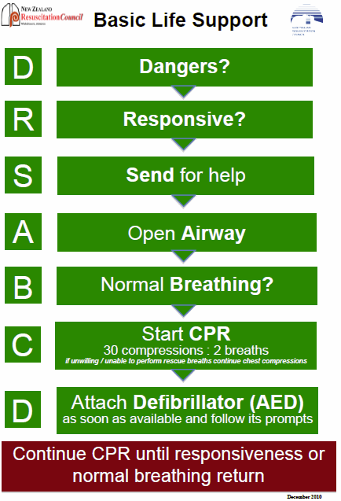
Notes:
As with many things the process is hopefully simplified by the introduction of an algorithm.
Danger - are you in danger, where are you?
Response – to verbal stimulus and light touch
Send for Help and an AED
Airway
Breathing- is it normal
Circulation – commence CPR
Defibrillation – attach as soon as it arrives

Slide 10
Danger
Are staff & patient safe?
Hazards
PPE
Gloves
Eyewear
Mask
Gown
Notes:
This is potentially a crisis – we need to mobilise all resources and not feel overwhelmed. First pay attention to the safety of yourself, other rescuers, and the patient. Eliminate danger if possible, or move the patient and staff to a place of safety. Wear PPE (personal protective equipment)

Slide 11
Response
Not responsive
Not breathing normally
Notes:
The Dec 2012 guidelines have removed references to ‘signs of life’ as this was felt to be too subjective.
The pulse check has also been de-emphasised as it was felt that rescuers often spent too long feeling for a pulse and were sometimes unreliable in ascertaining if a pulse were indeed present).
As such, the two main indicators to start CPR are:
The patient is not responsive, and
They are not breathing normally.
Not breathing normally:
It has also been highlighted recently that agonal gasps are a sign of cardiac arrest (ARC guideline 11.1.1)

Slide 12
Send for Help
Arrest Call, 000
Send for senior help
Send for a defibrillator

Slide 13
Airway
Check airway
Assess breathing
Commence CPR
Notes:
These are the decision points for A=Airway:
Is the airway patent? If not : remove foreign bodies such as food boluses or dentures. Then use the 3 airway opening manouevre, whichever is appropriate or effective: chin lift, jaw thrust and head tilt ( note which one not to use if cervical injury is suspected)
Is the patient breathing in a normal pattern?
Commence CPR if the patient’s condition remains: unresponsive with abnormal breathing pattern

Slide 14
Breathing
1 sec for each inspiration¹
Compression-only CPR if rescuer unable / unwilling to perform rescue breaths
Alternatives: barrier device ²
Notes:
When checking if the patient is breathing, it is important to look, listen and feel: look to see if the chest is rising and falling; listen to hear breath sounds at the mouth; and feel for breath against your cheek.
Compression-only CPR is not such an issue in hospital, as self-inflating (Laerdel, Ambubag) bags are available in the wards on arrest trolleys. This bypasses the need to deliver mouth-to-mouth, expired air resuscitation to patients. However, on the street or in the community, some rescuers feel uncomfortable or unable to deliver rescue breaths to a stranger they have found collapsed. The new guidelines make provision for this, given
the increased emphasis of compressions over ventilation, and
the thinking that some attempt at resuscitation is better than no attempt at all.
Of note, expired air resuscitation provides an FiO2 of only 15-18%³
There are also pocket disposable masks that people can use if they are concerned about the transmission of diseases. Note however that “a systematic review found no reports of transmission of hepatitis B, C, HIV or CMV during either training or actual CPR when high-risk activities, such as intravenous cannulation, were not performed” (ARC Guideline 8).
1 = Guideline 5
2 = Guideline 8
3 = Guideline 11.1

Slide 15
Circulation
CPR
Ratio 30:2
Compressions at a rate of 100/min
1/3 AP chest diameter
“Go hard, go fast”
Notes:
Several key messages:
We start with compressions (not rescue breaths), after we have assessed the airway and breathing and if we have found the patient to be unresponsive and not breathing normally.
Allow equal time for compression and relaxation⁴ & allow complete chest recoil post compression⁴
For CPR we need to “go hard, go fast” at a rate of 100/min (roughly to the beat of ‘stay alive, stay alive’), with our elbows straight and our shoulders directly above the person’s lower half of sternum. Effective external cardiac compression provides 20-30% of pre-arrest cardiac output. ⁵
It doesn’t matter if you have one or more than one rescuer: the ratio of compressions to breaths remains the same for adult patients.

Slide 16
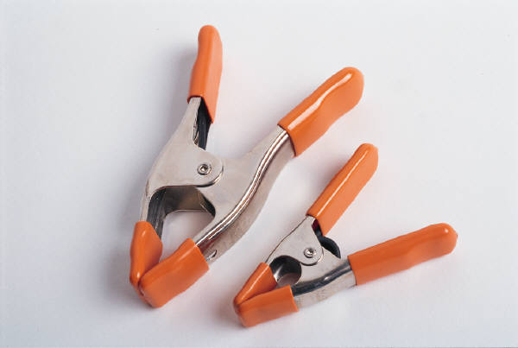
Defibrillation
Don’t wait!
AED will tell you
Manual defibrillator 200J biphasic
Notes:
If it’s a shockable rhythm, there is evidence that the chance of successful defibrillation decreases with time. “For every minute defibrillation is delayed, there is approximately a 10% reduction in survival if the victim is in cardiac arrest due to VF” (ARC Guideline 7). How would you know if it’s a shockable rhythm?
With an automated external defibrillator (AED), it will interpret the rhythm and advise if a shock is required, once the pads are applied.
With a manual defibrillator, rhythm interpretation by the operator is required. Hospital defibrillators may be semi-automated so it is important to familiarise yourself with the unit locally available. For shockable rhythms:
Precordial thump: The indications have narrowed to monitored pulseless VT with a defibrillator not immediately available. The new guidelines no longer include VF as it is felt to be “relatively ineffective for this rhythm” (ARC Guideline 11.3).
It is delivered as a single sharp blow to the midsternum, and should not be delivered for unwitnessed cardiac arrest, or in patients with a recent sternotomy or chest trauma (ARC Guideline 11.3)
Adhesive pads: Ensure you are at a minimum distance of 8cm away from any implanted pacemaker devices. Also do not apply the pads (or paddles) over medication patches as these may heat up and burn the patient’s skin. Remove the patch if it is in a location you require, and wipe the area prior to attaching the pad. The patch may otherwise also “block the delivery of energy from the electrode pad to the heart” (ARC Guideline 7).
Charge: We charge towards end of the 2min CPR to minimise the time without compressions. This is safe if we are using adhesive pads via a manual defibrillator (ARC Guideline 11.4)
We must also avoid having oxygen at high flows across the patient’s chest if delivering the shock using paddles; and avoid charging the paddles unless they are placed on the patient’s chest.
Some defibrillators have a ‘sync’ button. However this is not to be activated in VF or pulseless VT. We are aiming to deliver an unsynchronised shock.
It is an important responsibility of the person pressing the ‘charge’ button that they check everyone has stood clear prior to delivering the shock.
We need to resume CPR for a further 2 min post defibrillation as there is likely to be a period of myocardial stunning post arrest. It is therefore unlikely for the heart to immediately resume delivering an adequate perfusing pressure, even if sinus rhythm is restored. We are also unlikely to cause the patient harm by performing CPR during this interval: if the patient is perfusing their brain adequately, they will no doubt indicate this to you!

Slide 17
When to check a rhythm
Once a defibrillator is available
After 2 min CPR
Sooner if responsiveness or normal breathing occur.
Charge the defibrillator before stopping CPR
Notes:
It is important to be mindful to minimise time away from chest compressions. Studies have shown that common errors include excessive interruptions to external cardiac compressions (ARC guideline 11.1.1). This time can therefore also be utilised (while one person checks the rhythm), for the person administering CPR to change over.

Slide 18
Advanced Life Support
DRS ABCD plus
Defibrillation using manual defibrillator
IV/IO access
Drugs
Advanced airway techniques
Intubation
LMA placement

Slide 19
Notes:
Divided into Shockable (VT and pulseless VT) and Non-shockable (Asystole and PEA)

Slide 20
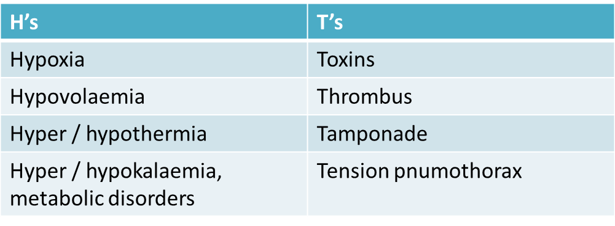
Reversible Causes
Notes:
Whilst 2 min (1 loop) of CPR is being performed and the record-keeper is also keeping track of time, it is worthwhile for the team leader (and any available team members) to think about possible reversible causes. These are known as the 4H’s and 4T’s.

Slide 21
Drugs used in ALS
Shockable
Adrenaline 1mg after 2nd shock (then every 2nd cycle)
Amiodarone 300mg after 3rd shock
Non-shockable
Adrenaline 1mg immediately (then every 2nd cycle)
At the time of recommencement of CPR.
Notes:
NB The ARC no longer recommends atropine.
What evidence is there for the drugs we use?
There is no evidence that either adrenaline or amiodarone increases the rate of survival to hospital discharge. However:
Adrenaline increases the return of spontaneous circulation
Amiodarone can improve the short-term outcome of survival to hospital admission in shock-refractory VF (vs placebo and lignocaine)
(Guideline 11.2)

Slide 22
Other Drugs
Drug | Indication
Calcium | Hypocalcaemia, hyperkalaemia, CCB OD
Lignocaine | substitute if amiodarone contraindicated
Magnesium | Torsade de pointes, dig toxicity, hypokalaemia, hypomagnesaemia
Potassium | Hypokalaemia
Sodium bicarbonate | TCA overdose, metabolic acidosis, >15min arrest, hyperkalaemia
Vasopressin | Alternative to adrenaline (insufficient evidence)
Thrombolytics | In adult cardiac arrest patients with proven or suspected pulmonary embolism
Notes:
Lignocaine is an alternative to amiodarone when the latter cannot be used.
Thrombolytics: ( reference: eTherapeutic Guidelines) http://etg.hcn.com.au/
The indication for the use of thrombolytics in PE are:
Ongoing hypotension < systolic of 90mmHg
Right heart failure
Severe hypoxaemia
Note that this is not evidence based and the role of thrombolytic is recognised as being limited. The accepted practice is anticoagulation.
If used:
Alteplace in the following way:
Weight > 65 kg: use 10mg IV bolus followed by 90mg infusion over 2 hours
Weight < 65 kg: use 10mg bolus followed by an infusion over 2 hours at a dose that is < 1.5mg/kg as the total dose ( ie infusion dose plus the bolus of 10mg)
The second line thrombolytic is streptokinase.

Slide 23
Advanced Airway Placement
When skilled help is available
Ideally: <20sec interruption to CPR
Then time with compressions
6-10 breaths per minute
do not pause compressions
Insert an LMA
Notes:
There is no proscribed time to intubate, or insert an LMA – it depends on the skill set of the rescuers.
It is ideal to give 100% O2 via a secured airway (endotracheal tube) if possible. However, it is also ideal for intubation to “not interrupt cardiac compressions at all” (ARC guideline 11.1.1), or for “less than 20 seconds” (ARC Guideline 11.2)
(Once you have secured the airway with an endotracheal tube, it is still important to time breaths in sequence with compressions):
Simultaneous delivery of breaths and compressions may adversely affect coronary perfusion, and “has been associated with decreased survival” (ARC guideline 11.1.1).
Aim for a ventilation rate of 6-10 breaths per minute:
A common error was noted to be excessive ventilation rates. Increasing the ventilation rate may increase intrathoracic pressure, decreasing coronary perfusion pressure. (ARC guideline 11.1.1). Also, “As with no cardiac output, in situations of limited cardiac output the requirements for ventilation will also be reduced” (ARC guideline 11.1.1)

Slide 24
Lets Practice

Slide 25
Scenario 1
Mr Robbie Williams
68 year old retired truck driver, presents with indigestion after eating a hamburger, has been triaged category 4. He has not seen a doctor in 45 years.
He has collapsed in the waiting room.

Slide 26
Scenario 2
Mike Tyson
27 year old male, dropped off by friends not breathing. The friends have left rapidly.
He need urgent assistance.
Notes:
The information here is to provide them with a history, context and prepare them for the simulation.

Slide 27
Summary
BLS uses the DRS ABCD algorithm
Early CPR and Defibrillation are the primary aims
Safe defibrillation techniques protect rescuers
Drugs and Airway skills are adjuncts to ALS
Communicate carefully in cardiac arrest situations

Slide 28
Acknowledgments
C4 Topic expert author: Sandra Cheng
C4 Simulation session author: Sandra Cheng
Cardiac Module Expert Working Party and Peer Review Team Michael Bastick FACEM Gosford Hospital Sandra Cheng Simulation Fellow SCSSC John Kennedy FACEM Royal North Shore Hospital Marian Lee FACEM Prince of Wales Hospital John McKenzie FACEM Australian Institute for Clinical Education (AICE) Clare Richmond FACEM Royal Prince Alfred Hospital Morgan Sherwood Simulation Fellow SCSSC Timothy Tan Simulation Fellow SCSSC John Vassiliadis FACEM Royal North Shore Hospital
Educational consultants:
Stephanie O’Regan Nurse Educator SCSSC Leonie Watterson Director Simulation Division SCSSC John Vassiliadis Deputy Director SCSSC
Clare Richmond FACEM Royal Prince Alfred Hospital Morgan Sherwood Simulation Fellow SCSSC

Slide 29
Disclaimer Care has been taken to confirm the accuracy of the information presented and to describe generally accepted practices. However the authors, editor and publisher are not responsible for errors or omissions or for any consequences from the application of the information in this presentation and make no warranty, express or implied, with respect to the contents of the presentation.
Copyright and Permission to Reproduce
This work is copyright. It may be reproduced for study or training purposes subject to the inclusion of an acknowledgement of the source: Health Workforce Australia EdWISE program. It may not be reproduced for commercial usage or sale.

